Slide 1
Chapter 2 Operating System Overview
Operating Systems: Internals and Design Principles
Ninth Edition
By William Stallings
Notes:
“Operating Systems: Internal and Design Principles”,9/e, by William Stallings, Chapter 2 “Operating System Overview”.

Slide 2
Objectives
Understand Time Sharing Systems
Differences between Batch Multiprogramming and Time Sharing Systems
OS Design Principles
OS Protection Boundary
OS Services
Systems Calls
Types of OS
Notes:
Briefly, the OS typically provides services in the following areas:
• Program development: The OS provides a variety of facilities and services,
such as editors and debuggers, to assist the programmer in creating programs.
Typically, these services are in the form of utility programs that, while not
strictly part of the core of the OS, are supplied with the OS and are referred to
as application program development tools.
• Program execution: A number of steps need to be performed to execute a
program. Instructions and data must be loaded into main memory, I/O devices
and files must be initialized, and other resources must be prepared. The OS
handles these scheduling duties for the user.
• Access to I/O devices: Each I/O device requires its own peculiar set of instructions
or control signals for operation. The OS provides a uniform interface
that hides these details so that programmers can access such devices using simple
reads and writes.
• Controlled access to files: For file access, the OS must reflect a detailed understanding
of not only the nature of the I/O device (disk drive, tape drive) but
also the structure of the data contained in the files on the storage medium.
In the case of a system with multiple users, the OS may provide protection
mechanisms to control access to the files.
• System access: For shared or public systems, the OS controls access to the
system as a whole and to specific system resources. The access function must
provide protection of resources and data from unauthorized users and must
resolve conflicts for resource contention.
• Error detection and response: A variety of errors can occur while a computer
system is running. These include internal and external hardware errors, such
as a memory error, or a device failure or malfunction; and various software
errors, such as division by zero, attempt to access forbidden memory location,
and inability of the OS to grant the request of an application. In each case,
the OS must provide a response that clears the error condition with the least
impact on running applications. The response may range from ending the program
that caused the error, to retrying the operation, to simply reporting the
error to the application.
• Accounting: A good OS will collect usage statistics for various resources and
monitor performance parameters such as response time. On any system, this
information is useful in anticipating the need for future enhancements and in
tuning the system to improve performance. On a multiuser system, the information
can be used for billing purposes.

Slide 3
Time-Sharing Systems
Can be used to handle multiple interactive jobs
Processor time is shared among multiple users
Multiple users simultaneously access the system through terminals, with the OS interleaving the execution of each user program in a short burst or quantum of computation
Notes:
Just as multiprogramming allows the processor to handle multiple batch jobs
at a time, multiprogramming can also be used to handle multiple interactive jobs. In
this latter case, the technique is referred to as time sharing , because processor time is
shared among multiple users. In a time-sharing system, multiple users simultaneously
access the system through terminals, with the OS interleaving the execution of each
user program in a short burst or quantum of computation. Thus, if there are n users
actively requesting service at one time, each user will only see on the average 1/ n
of the effective computer capacity, not counting OS overhead. However, given the
relatively slow human reaction time, the response time on a properly designed system
should be similar to that on a dedicated computer.

Slide 4
Table 2.3 Batch Multiprogramming versus Time Sharing
Notes:
Both batch processing and time sharing use multiprogramming. The key
differences are listed in Table 2.3 .

Slide 5
Compatible Time-Sharing System (CTSS)
One of the first time-sharing operating systems
Developed at MIT by a group known as Project MAC
The system was first developed for the IBM 709 in 1961
Ran on a computer with 32,000 36-bit words of main memory, with the resident monitor consuming 5000 of that
Utilized a technique known as time slicing
System clock generated interrupts at a rate of approximately one every 0.2 seconds
At each clock interrupt the OS regained control and could assign the processor to another user
Thus, at regular time intervals the current user would be preempted and another user loaded in
To preserve the old user program status for later resumption, the old user programs and data were written out to disk before the new user programs and data were read in
Old user program code and data were restored in main memory when that program was next given a turn
Notes:
One of the first time-sharing operating systems to be developed was the
Compatible Time-Sharing System (CTSS) [CORB62], developed at MIT by a
group known as Project MAC (Machine-Aided Cognition, or Multiple-Access
Computers). The system was first developed for the IBM 709 in 1961 and later
transferred to an IBM 7094.
Compared to later systems, CTSS is primitive. The system ran on a computer
with 32,000 36-bit words of main memory, with the resident monitor consuming 5000
of that. When control was to be assigned to an interactive user, the user’s program
and data were loaded into the remaining 27,000 words of main memory. A program
was always loaded to start at the location of the 5000th word; this simplified
both the monitor and memory management. A system clock generated interrupts
at a rate of approximately one every 0.2 seconds. At each clock interrupt, the OS
regained control and could assign the processor to another user. This technique is
known as time slicing . Thus, at regular time intervals, the current user would be
preempted and another user loaded in. To preserve the old user program status for
later resumption, the old user programs and data were written out to disk before the
new user programs and data were read in. Subsequently, the old user program code
and data were restored in main memory when that program was next given a turn.

Slide 6
Notes:
To minimize disk traffic, user memory was only written out when the incoming
program would overwrite it. This principle is illustrated in Figure 2.7 . Assume that
there are four interactive users with the following memory requirements, in words:
• JOB1: 15,000
• JOB2: 20,000
JOB3: 5000
• JOB4: 10,000
Initially, the monitor loads JOB1 and transfers control to it (a). Later, the
monitor decides to transfer control to JOB2. Because JOB2 requires more memory
than JOB1, JOB1 must be written out first, and then JOB2 can be loaded (b).
Next, JOB3 is loaded in to be run. However, because JOB3 is smaller than JOB2,
a portion of JOB2 can remain in memory, reducing disk write time (c). Later, the
monitor decides to transfer control back to JOB1. An additional portion of JOB2
must be written out when JOB1 is loaded back into memory (d). When JOB4 is
loaded, part of JOB1 and the portion of JOB2 remaining in memory are retained
(e). At this point, if either JOB1 or JOB2 is activated, only a partial load will be
required. In this example, it is JOB2 that runs next. This requires that JOB4 and the
remaining resident portion of JOB1 be written out and that the missing portion of
JOB2 be read in (f).

Slide 7
OS Design Principles
Principle 1: Separation between Mechanism and Policies
We want to implement flexible mechanism to support many policies
Example:
LRU, LFU( Less Frequently Used), Random (These are policies)
Mechanism to track the frequency of access
Principle 2: Optimize for Common Case
Where will be the OS used
In what kind of machine the OS will run
How many cores, processors, etc
What are the workload requirements
You need to understand the common case, based on that case you will choose a specific policy that makes sense and that can be supported given the underlying mechanism and abstractions → Understand what you need to do

Slide 8

OS Protection Boundary
User Level
(unprivileged kernel mode)
Applications Are located here
BOUNDARY
OS
Privileged direct access to HW
Kernel Level
(Privileged kernel mode)
Bit (Privileged Bit)
If Set
Any instruction that manipulates HW is allowed to execute
If NOT Set
And an instruction from user mode tries a privileged action, a TRAP will be generated
CPU

Slide 9
OS Design Principles
Crossing is supported by the hardware (Privileged bit)
When a trap occurs:
The responsible task will be interrupted and control passed to the OS.
The OS will examine the case and it will decided if it is valid or if the task responsible for the trap must be terminated.

Slide 10
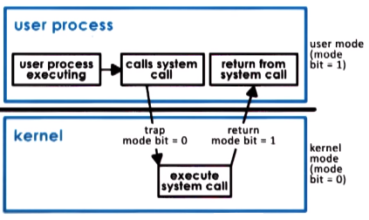
System Call Flow Chart

Slide 11
OS Protection Boundary
In conclusion system calls are very time consuming
Why ?
Write Arguments
Save relevant data at a well defined location
Make system call
Expensive = no cheap = Time consuming
And we have not mention that it also affects cache
MM = 100ths of cycles
Cache = Cycles

Slide 12
OS Services
An OS Provides applications with access to the underlying HW. This is done via Services.
Scheduler (Access to CPU)
Memory Manager (allocates memory, protection)
Block Device Driver (access to disk)
2. For app developers those services are available via system calls
3. For management (OS)
Process
File
Device
Memory
Security and many more

Slide 13
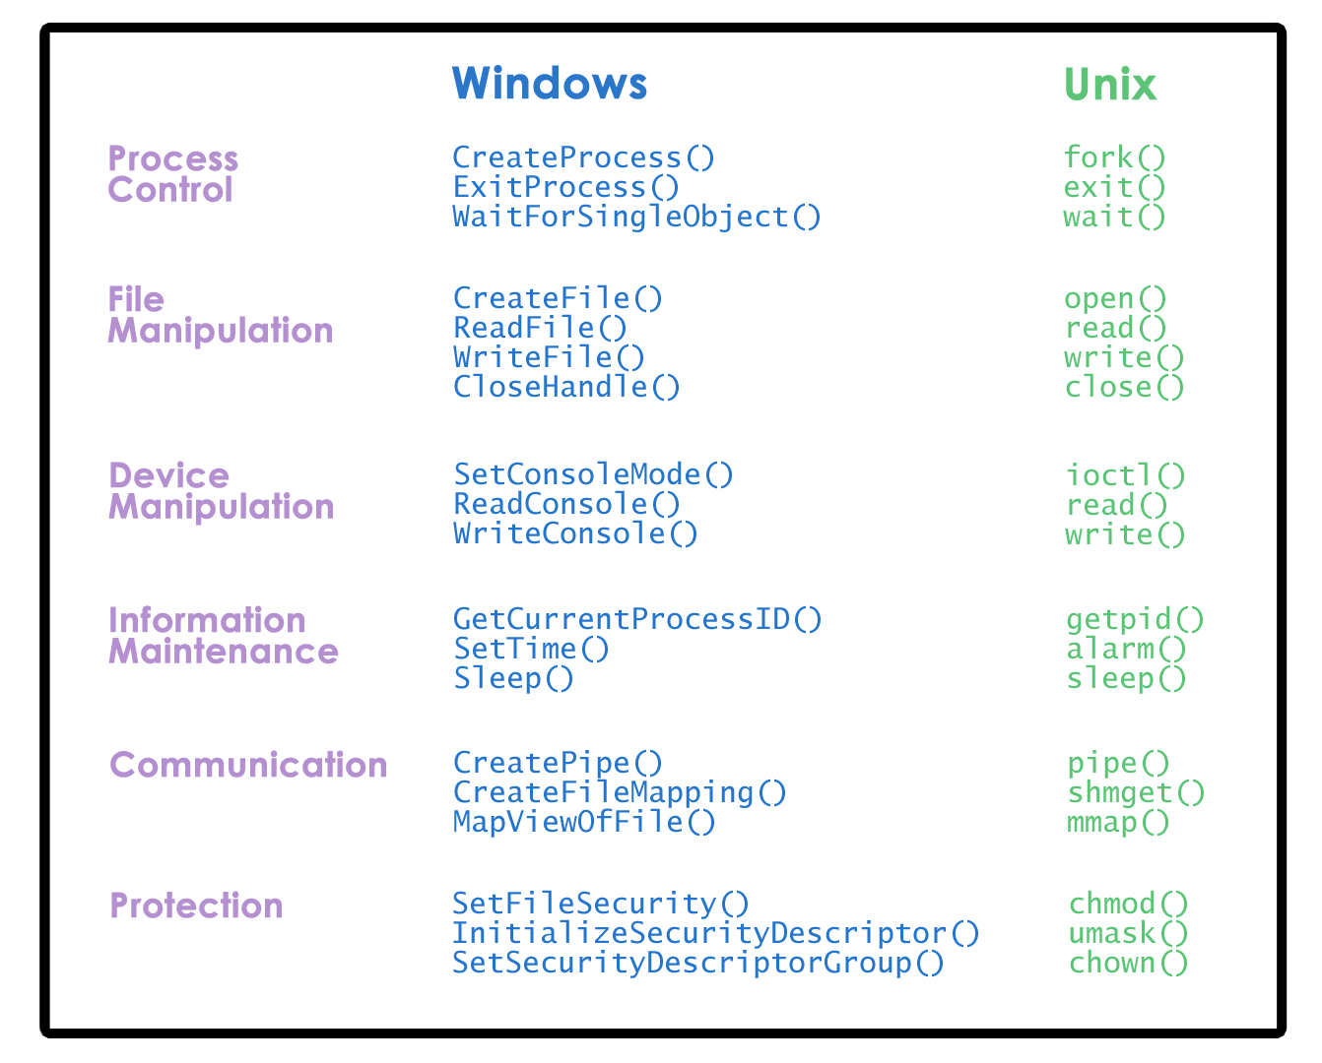

Slide 14
Types of OS
Monolithic
Modular
Micro Kernel

Slide 15
Monolithic OS
It was the very 1st type of design
In this type of OS, any service that any application or hardware may require is already part of the OS, for example
File System for Random I/O (Data Bases)
File Systems for sequential I/O (For other activities not related to DB)
Process and Threads
File Management
Device Drivers
Memory Management
PROS
Everything that is needed is already included (abstractions, services)
CONS
Large, to much code, debugging
Customization
Portability
Memory footprint
Performance

Slide 16
Modular OS
It was the very 2nd type of design (LINUX)
In this type of OS, any service that any application or hardware may require `CAN BE ADDED as a MODULE
The OS specifies certain type of interfaces that any module needs to implement if it wants to become part of the OS.
You can dynamically install new modules in the OS
DB → Lets install and run the random File system
No DB → Lets install and run a sequential File System
PROS
Customizable
Modular
Easy to maintain
Smaller footprint
Less resources needed
Better Performance
CONS
Indirectly can impact performance
Although easier, maintenance can still be an issue because the code for different modules may come from different despaired source, which may be a source of bugs

Slide 17
Micro Kernel type OS
APP1
Dbase
APP2
File System
APP3
Disk Driver
User Mode
App1, App2, App3 will RUN OUT of the Kernel Level
BOUNDARY
Kernel Mode
IPC
Address Space
Threads
CPU
MM

Slide 18
Micro Kernel type OS
OS for Embedded kind of devices
Only require the most basic primitives at the OS Level.
PROS
Very Small
Low Overhead
Good Performance
Easy to verify/Test that the code does what is expected to do
CONS
Portability (hurt because it is very customized)
Complexity of SW development
Cost of Kernel Crossing

Slide 19
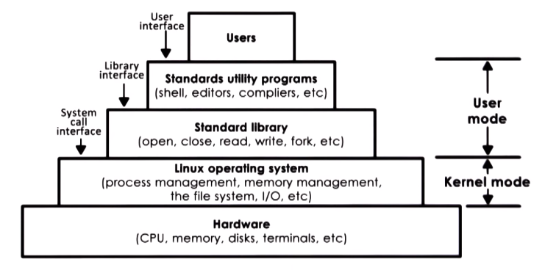
Linux Architecture

Slide 20
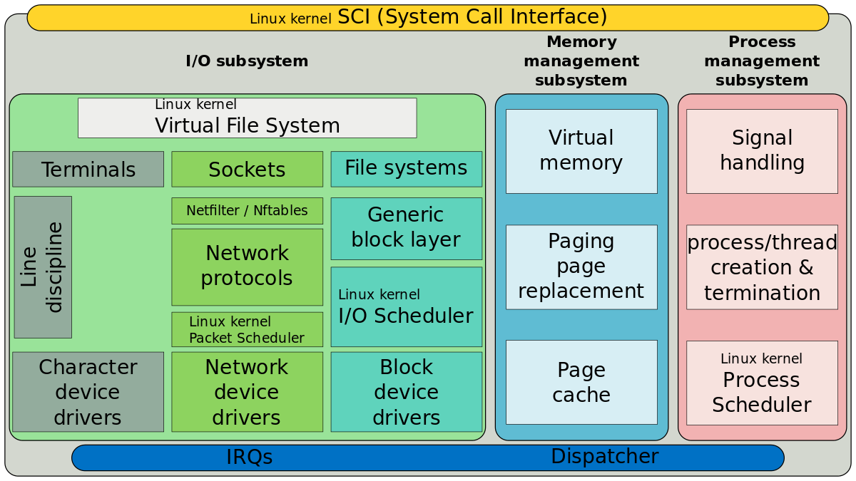
Linux Kernel (Arch)

Slide 21
Process
Fundamental to the structure of operating systems
A process can be defined as:
A program in execution
An instance of a running program
The entity that can be assigned to, and executed on, a processor
A unit of activity characterized by a single sequential thread of execution, a current state, and an associated set of system resources
Notes:
Central to the design of operating systems is the concept of process. This term was
first used by the designers of Multics in the 1960s [DALE68]. It is a somewhat
more general term than job. Many definitions have been given for the term process ,
including
• A program in execution
• An instance of a program running on a computer
• The entity that can be assigned to and executed on a processor
• A unit of activity characterized by a single sequential thread of execution, a
current state, and an associated set of system resources

Slide 22
Process
State of Execution
Parts and temporary Holding Area
May require special Hardware
Let’s examine each one of these

Slide 23
Process
State of Execution
Program Counter (PC)
Stack Pointer (SP)
These info will be used by and will help the OS to decide how to schedule the process or how to swap multiple processes among other tasks.

Slide 24
Process
Parts and Temporary holding Area
To execute the process needs data
We need to know the status of the corresponding registries associated with the process(es)
It also has a holding area (memory)

Slide 25
Process
May Require HW access
I/O
Disk
Network

Slide 26
Process (Definition)
Application → Example Word → is a Static Entity
Application is launched (executed and loaded in memory) → it Becomes → Dynamic Entity → Process

Slide 27
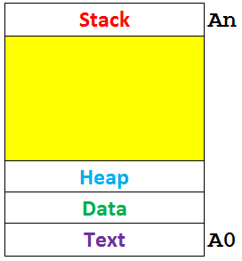
What does a process looks like?
A process pretty much encloses all the state of a running applications, this includes all the elements on the figure on the left.
The OS provides an abstraction to work on it, and such abstraction is given in the form of an address space (from A0 to An) (IN MAIN MEMORY)
Text (Code) and Data: Known as static state, because these are available when the process 1st initialize.
Heap:
This section is dynamically created during execution
Stack:
LIFO
Shrinks and grows during execution

Slide 28
What does a process looks like?
Addresses [A0, An] are VA (Virtual Addresses).
Virtual Addresses: These addresses are not physical Main Memory addresses (MMA).
Main Memory Addresses are known as Physical Main Memory Addresses.
The responsibles for taking care of the mapping between VA and MMA are
Memory Managing HW
Page Tables (OS Component)
A page Table Entry
0x01F9 | 0x0A0A
{VA | MMA}

Slide 29
What does a process looks like?
Addresses [A0, An] are VA (Virtual Addresses).
Virtual Addresses: These addresses are not physical Main Memory addresses (MMA).
Main Memory Addresses are known as Physical Main Memory Addresses.
The responsibles for taking care of the mapping between VA and MMA are
Memory Managing HW
Page Tables (OS Component)
A page Table Entry
0x01F9 | 0x0A0A
{VA | MMA}

Slide 30
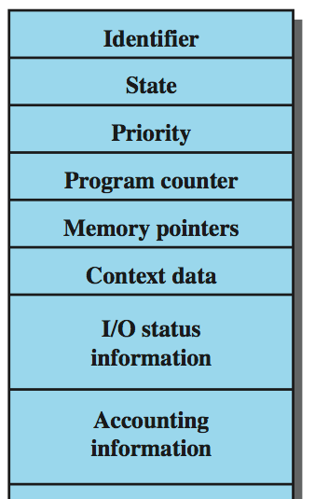
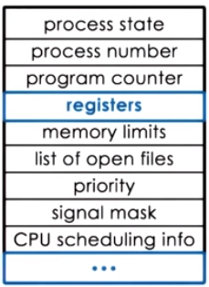
How does the OS know what a process is doing.
PCB - What does it mean?:
Process Control Block
What is it?
It is a data structure that the OS maintains for each process that it manages.
What else ?
Created and initialized when the process is initially created, example: PC (Program Counter) will be set to point into the very 1st instruction in that process.
Some Fields will be dynamically modified, for example: imagine that a process requests more memory, if granted the OS will update “memory limits”
Some will change quite frequently. Example PC. CPU will take care of it.

Slide 31
Process
Context Switch
It can be defined as the mechanism used by the OS to switch the execution from the context of one process to the context of another process.
Context Switch is Expensive
Direct Cost:
The number of cycles associated with all the loading and store instructions
Indirect Cost:
Processor cache

Slide 32
Causes of Errors
Improper synchronization
It is often the case that a routine must be suspended awaiting an event elsewhere in the system
Improper design of the signaling mechanism can result in loss or duplication
Nondeterminate program operation
When programs share memory, and their execution is interleaved by the processor, they may interfere with each other by overwriting common memory areas in unpredictable ways
The order in which programs are scheduled may affect the outcome of any particular program
Failed mutual exclusion
More than one user or program attempts to make use of a shared resource at the same time
There must be some sort of mutual exclusion mechanism that permits only one routine at a time to perform an update against the file
Deadlocks
It is possible for two or more programs to be hung up waiting for each other
Notes:
The principal tool available to system programmers in developing the early
multiprogramming and multiuser interactive systems was the interrupt. The activity
of any job could be suspended by the occurrence of a defined event, such as an I/O
completion. The processor would save some sort of context (e.g., program counter
and other registers) and branch to an interrupt-handling routine, which would determine
the nature of the interrupt, process the interrupt, and then resume user processing
with the interrupted job or some other job.
The design of the system software to coordinate these various activities turned
out to be remarkably difficult. With many jobs in progress at any one time, each of
which involved numerous steps to be performed in sequence, it became impossible
to analyze all of the possible combinations of sequences of events. In the absence of
some systematic means of coordination and cooperation among activities, programmers
resorted to ad hoc methods based on their understanding of the environment
that the OS had to control. These efforts were vulnerable to subtle programming
errors whose effects could be observed only when certain relatively rare sequences
of actions occurred. These errors were difficult to diagnose because they needed to
be distinguished from application software errors and hardware errors. Even when
the error was detected, it was difficult to determine the cause, because the precise
conditions under which the errors appeared were very hard to reproduce. In general
terms, there are four main causes of such errors [DENN80a]:
Improper synchronization:
It is often the case that a routine must be suspended
awaiting an event elsewhere in the system. For example, a program that initiates
an I/O read must wait until the data are available in a buffer before proceeding.
In such cases, a signal from some other routine is required. Improper design
of the signaling mechanism can result in signals being lost or duplicate signals
being received.
Failed mutual exclusion:
It is often the case that more than one user or program
will attempt to make use of a shared resource at the same time. For example,
two users may attempt to edit the same file at the same time. If these accesses
are not controlled, an error can occur. There must be some sort of mutual exclusion
mechanism that permits only one routine at a time to perform an update
against the file. The implementation of such mutual exclusion is difficult to
verify as being correct under all possible sequences of events.
Nondeterminate program operation:
The results of a particular program normally
should depend only on the input to that program and not on the activities
of other programs in a shared system. But when programs share memory, and
their execution is interleaved by the processor, they may interfere with each
other by overwriting common memory areas in unpredictable ways. Thus, the
order in which various programs are scheduled may affect the outcome of any
particular program.
Deadlocks:
It is possible for two or more programs to be hung up waiting for
each other. For example, two programs may each require two I/O devices to perform
some operation (e.g., disk to tape copy). One of the programs has seized
control of one of the devices and the other program has control of the other
device. Each is waiting for the other program to release the desired resource.
Such a deadlock may depend on the chance timing of resource allocation and
release.

Slide 33
Components of a Process
A process contains three components:
An executable program
The associated data needed by the program (variables, work space, buffers, etc.)
The execution context (or “process state”) of the program
The execution context is essential:
It is the internal data by which the OS is able to supervise and control the process
Includes the contents of the various process registers
Includes information such as the priority of the process and whether the process is waiting for the completion of a particular I/O event
Notes:
We can think of a process as consisting of three components:
• An executable program
• The associated data needed by the program (variables, work space, buffers, etc.)
• The execution context of the program
This last element is essential.
The execution context, or process state, is the internal data by which the OS is able to supervise and control the process.
This internal information is separated from the process, because the OS has information not permitted to the process.
The context includes all of the information that the OS needs to manage the process and that the processor needs to execute the process properly including:
contents of the various processor registers, such as the program counter and data registers
And information of use to the OS, such as the priority of the process and whether the process is waiting for the completion of a particular I/O event.

Slide 34
Let’s look into this more carefully
Conditions:
Two process (P1, P2)
MM {PCB_P1, PCB_P2}
CPU {Registers = Only One PCB at a Time}
Students: Take Notes

Slide 35
Process Management
The entire state of the process at any instant is contained in its context
New features can be designed and incorporated into the OS by expanding the context to include any new information needed to support the feature
Notes:
Figure 2.8 indicates a way in which processes may be managed. Two processes,
A and B, exist in portions of main memory. That is, a block of memory is
allocated to each process that contains the program, data, and context information.
Each process is recorded in a process list built and maintained by the OS. The
process list contains one entry for each process, which includes a pointer to the
location of the block of memory that contains the process. The entry may also
include part or all of the execution context of the process. The remainder of the
execution context is stored elsewhere, perhaps with the process itself (as indicated
in Figure 2.8 ) or frequently in a separate region of memory. The process index
register contains the index into the process list of the process currently controlling
the processor. The program counter points to the next instruction in that process
to be executed. The base and limit registers define the region in memory occupied
by the process: The base register is the starting address of the region of memory
and the limit is the size of the region (in bytes or words). The program counter and
all data references are interpreted relative to the base register and must not exceed
the value in the limit register. This prevents interprocess interference.
In Figure 2.8 , the process index register indicates that process B is executing.
Process A was previously executing but has been temporarily interrupted. The
contents of all the registers at the moment of A’s interruption were recorded in its
execution context. Later, the OS can perform a process switch and resume execution
of process A. The process switch consists of storing the context of B and restoring
the context of A. When the program counter is loaded with a value pointing into A’s
program area, process A will automatically resume execution.

